Slide 1
End-to-End Protocols (Chapter 5)

Slide 2
Outline
Simple De/Multiplexer (UDP)
Reliable Byte Stream (TCP)

Slide 3
End-to-end Protocols
Common properties that a transport protocol can be expected to provide
Supports multiple application processes on each host
Guarantees message delivery
Delivers messages in the same order they were sent
Delivers at most one copy of each message
Supports arbitrarily large messages
Supports synchronization between the sender and the receiver
Allows the receiver to apply flow control to the sender

Slide 4
End-to-end Protocols
Typical limitations of the network on which transport protocol will operate
Drop messages
Reorder messages
Deliver duplicate copies of a given message
Limit messages to some finite size
Deliver messages after an arbitrarily long delay
Challenge for Transport Protocols
Develop algorithms that turn the less-than-desirable properties of the underlying network into the high level of service required by application programs

Slide 5
End-to-end Issues
Process-to-process communication over the Internet rather than a point-to-point link
Supporting logical connections between processes that are running on two different computers in the Internet
Deal with widely different RTT times
Deal with packet reordering in the Internet
Learn what resources the other side is able to apply to the connection
Learn the capacity of the network

Slide 7
Simple Demultiplexer (UDP)
Extends host-to-host delivery service of the underlying network into a process-to-process communication service
Adds a level of demultiplexing which allows multiple application processes on each host to share the network

Slide 8
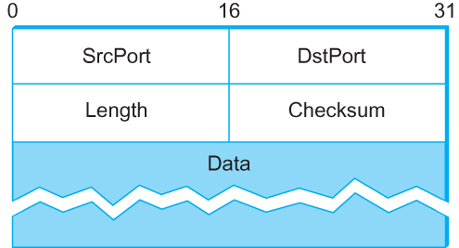
Simple Demultiplexer (UDP)
Format for UDP header (Note: length and checksum fields should be switched)

Slide 9
UDP checksum
Goal: detect “errors” (e.g., flipped bits) in transmitted segment
sender:
treat segment contents, including header fields, as sequence of 16-bit integers
checksum: addition (one’s complement sum) of segment contents
sender puts checksum value into UDP checksum field
receiver:
compute checksum of received segment
check if computed checksum equals checksum field value:
NO - error detected
YES - no error detected. But maybe errors nonetheless? More later ….

Slide 10
Internet checksum: example
example: add two 16-bit integers
1 1 1 1 0 0 1 1 0 0 1 1 0 0 1 1 0
1 1 1 0 1 0 1 0 1 0 1 0 1 0 1 0 1
1 1 0 1 1 1 0 1 1 1 0 1 1 1 0 1 1
1 1 0 1 1 1 0 1 1 1 0 1 1 1 1 0 0
1 0 1 0 0 0 1 0 0 0 1 0 0 0 0 1 1
wraparound
sum
checksum
Note: when adding numbers, a carryout from the most significant bit needs to be added to the result
Notes:
Kurose and Ross forgot to say anything about wrapping the carry and adding it to low order bit

Slide 11
Reliable Byte Stream (TCP)
In contrast to UDP, Transmission Control Protocol (TCP) offers the following additional services
Reliable
Connection oriented
Byte-stream service
Congestion control
Flow control

Slide 12
Flow control VS Congestion control
Flow control
About sender vs. receiver
preventing senders from overrunning the capacity of the receivers
Congestion control
About sender vs. network
preventing too much data from being injected into the network, thereby causing switches/routers to become overloaded

Slide 13
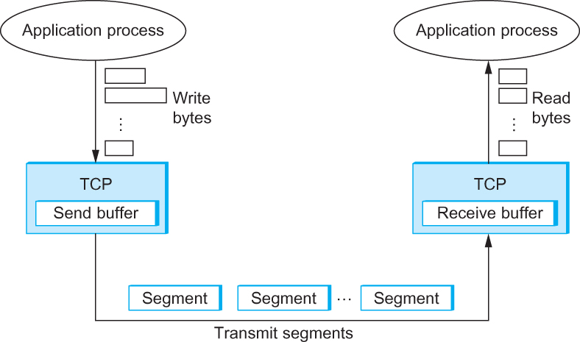
TCP Segment
How TCP manages a byte stream.

Slide 14
TCP segment structure
32 bits
URG: urgent data
(generally not used)
counting
by bytes
of data
(not segments!)
source port #
dest port #
sequence number
ACK: ACK #
valid
acknowledgement number
head
len
not
used
U
receive window
A
PSH: push data now
(generally not used)
P
R
S
F
# bytes
rcvr willing
to accept
checksum
Urg data pointer
RST, SYN, FIN:
connection estab
(setup, teardown
commands)
options (variable length)
application
data
(variable length)
Internet
checksum
(as in UDP)

Slide 15

TCP seq. numbers, ACKs
Host A
Host B
User
types
‘C’
Seq=42, ACK=79, data = ‘C’
host ACKs
receipt of
‘C’, echoes
back ‘C’
Seq=79, ACK=43, data = ‘C’
host ACKs
receipt
of echoed
‘C’
Seq=43, ACK=80
simple telnet scenario

Slide 16
Adaptive Retransmission
Q: how to set TCP timeout value?
longer than RTT
but RTT varies
too short: premature timeout, unnecessary retransmissions
too long: slow reaction to segment loss
Q: how to estimate RTT?
SampleRTT: measured time from segment transmission until ACK receipt
ignore retransmissions
SampleRTT will vary, want estimated RTT “smoother”
average several recent measurements, not just current SampleRTT

Slide 17
TCP round trip time, timeout
EstimatedRTT = (1- α)*EstimatedRTT + α*SampleRTT
exponential weighted moving average
influence of past sample decreases exponentially fast
typical value: α = 0.125
RTT: gaia.cs.umass.edu to fantasia.eurecom.fr
RTT (milliseconds)
sampleRTT
EstimatedRTT
time (seconds)

Slide 18
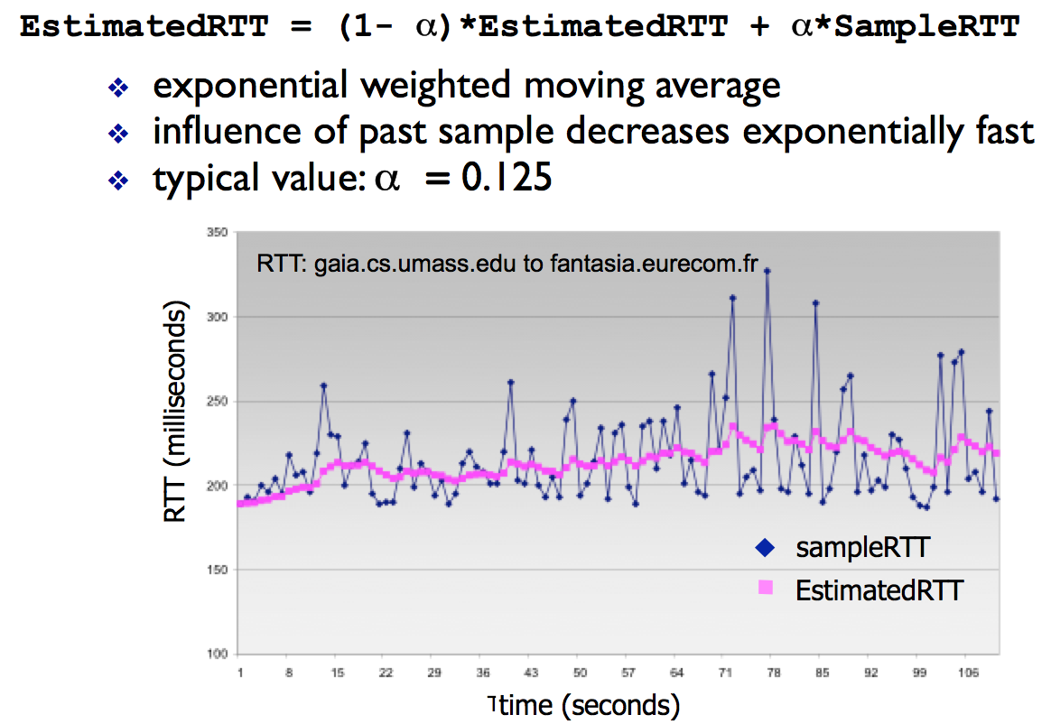

Slide 19

TCP round trip time, timeout
timeout interval: EstimatedRTT plus “safety margin”
large variation in EstimatedRTT -> larger safety margin
estimate SampleRTT deviation from EstimatedRTT:
DevRTT = (1-β)*DevRTT +
β*|SampleRTT-EstimatedRTT|
(typically, β = 0.25)
TimeoutInterval = EstimatedRTT + 4*DevRTT
estimated RTT
“safety margin”

Slide 20
Adaptive Retransmission
Measure SampleRTT for each segment/ ACK pair
Compute weighted average of RTT
EstRTT = α x EstRTT + (1 - α )x SampleRTT
α between 0.8 and 0.9
Set timeout based on EstRTT
Karn/Partridge’s
TimeOut = 2 x EstRTT
or
Jacobson/Karels’s
Timeout = EstRTT + 4*DevRTT

Slide 21
TCP flow control
application
process
application may
remove data from
TCP socket buffers ….
application
TCP socket
receiver buffers
OS
… slower than TCP
receiver is delivering
(sender is sending)
TCP
code
flow control
IP
code
receiver controls sender, so sender won’t overflow receiver’s buffer by transmitting too much, too fast
from sender
receiver protocol stack

Slide 22
TCP flow control
receiver “advertises” free buffer space by including rwnd value in TCP header of receiver-to-sender segments
RcvBuffer size set via socket options (typical default is 4096 bytes)
many operating systems autoadjust RcvBuffer
sender limits amount of unacked (“in-flight”) data to receiver’s rwnd value
guarantees receive buffer will not overflow
to application process
RcvBuffer
buffered data
rwnd
free buffer space
TCP segment payloads
receiver-side buffering

Slide 23
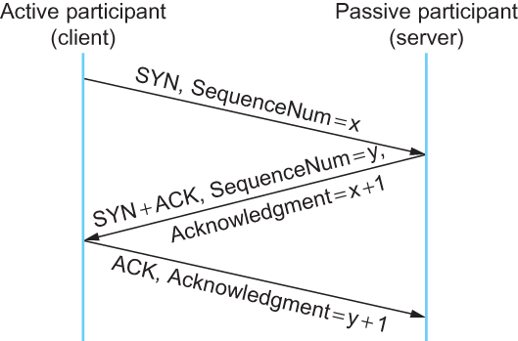
Connection Establishment/Termination in TCP
Timeline for three-way handshake algorithm

Slide 24
TCP: closing a connection
client, server each close their side of connection
send TCP segment with FIN bit = 1
respond to received FIN with ACK
on receiving FIN, ACK can be combined with own FIN
simultaneous FIN exchanges can be handled

Slide 25
TCP: closing a connection
client state
server state
ESTAB
ESTAB
clientSocket.close()
FIN_WAIT_1
can no longer
send but can
receive data
FINbit=1, seq=x
CLOSE_WAIT
ACKbit=1; ACKnum=x+1
can still
send data
FIN_WAIT_2
wait for server
close
LAST_ACK
FINbit=1, seq=y
TIMED_WAIT
can no longer
send data
ACKbit=1; ACKnum=y+1
timed wait
for 2*max
segment lifetime
CLOSED
CLOSED

